Slide 1



Explainability in NLP model: Detection of Covid-19 Twitter Fake News
Wan Yit Yong, Rajesh Jaiswal, Fernando Perez Tellez
December 14 2023 - HCAI-ep conference 2023

Slide 2
Presentation Outline
Introduction
Methodology
XAI
1
3
5
2
4
6
Objectives of Research
Results & Discussion
Conclusion

Slide 3

Fake news is cheap to produce. Genuine journalism is expensive -Toomas Hendrik IIves
[1] - Toomas Hendrik Ilves - Wikipedia

Slide 4
Do you fact-check the news before believing it?

Slide 5




Examples of Fake news related to COVID-19

Slide 6
Objectives of the Research
Compare ML models that classifies Covid-19 Twitter news into fake and real
Use a taxonomy of XAI to explain how a ML model makes the decision.
Notes:
Based on the available research, it is evident that machine learning algorithms can be effective in detecting fake news related to COVID-19. Specifically, models such as Naive Bayes, Linear SVC, Logistic Regression, Decision Tree, and Random Forest have all shown promising results when applied to datasets containing COVID-19-related news articles.
Additionally, the choice of vectorizer, whether it be count or TF-IDF, can impact the performance of these models. In the experiments conducted in this study, TF-IDF vectorizer resulted in better performance for most of the models.
However, it is important to note that the detection of fake news related to COVID-19 is a complex task that requires careful consideration of various factors such as the sources of the news articles, the language used in the articles, and the context in which the articles are presented. Therefore, while machine learning algorithms can be useful in detecting fake news related to COVID-19, they should not be solely relied upon and should be complemented with human expertise and critical thinking.

Slide 7
Methodology
Data Exploration & Preprocessing
Feature Extraction
Machine Learning Methods
Evaluation

Slide 8
Methodology Overview
Data Exploration, Preprocessing
Text Normalization, Stop-words Removal, Tokenization
Feature Extraction
Count Vectorizer, Term Frequency-Inverse Document Frequency (TF-IDF) Vectorizer
Machine Learning Models
Naïve Bayes Classifier, Support Vector Machine, Logistic Regression, Decision Tree, Random Forest
Evaluation
Accuracy, Precision, Recall, F1-score, Confusion Matrix

Slide 9
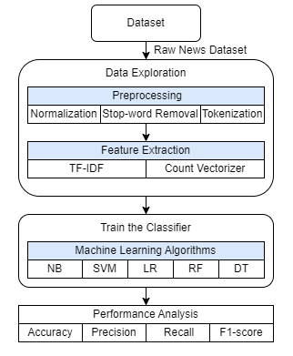
Clean Data
Clean Data

Slide 10
Dataset
CovidFakeNews Dataset
Provided by Patwa P (2021)[2]
10700 Twitter tweets
52.34% real news and 47.66% fake news
 | Fake | Real | Combined
Unique Words | 19728 | 22916 | 37503
Avg words per post | 21.65 | 31.97 | 27.05
Avg chars per post | 143.26 | 218.37 | 182.57
[2] - COVID19 Fake News Dataset NLP

Slide 11
Data Preprocessing
Text Normalization | Cleaning and standardizing text into uniform format
Stop-words Removal | Remove stop words frequently occur that do not affect
Tokenization | Breaking down sentence into individual component

Slide 12
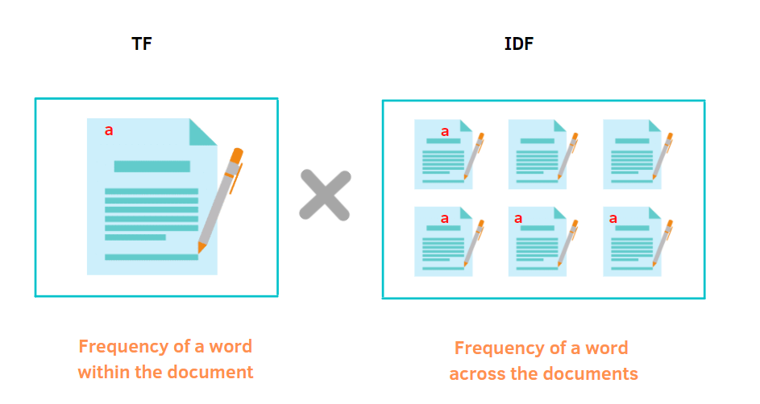
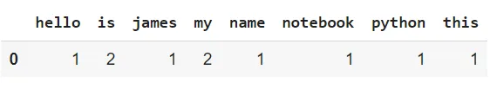
Feature Extraction
TF-IDF Vectorizer
Count Vectorizer
text = [‘Hello my name is james, this is my python notebook’]

Slide 13
ML methods
Advantages: Less complex, Scales well, Can handle high-dimensional data
Disadvantages: Subject to Zero frequency
Naive Bayes
Advantages: Memory efficient, Accurate in high-dimensional data
Disadvantages: Prone to overfitting, Small datasets
Support Vector Machine
Advantages: Simple to implement, can handle continuous and categorical variables
Disadvantages: Sensitive to outliers
Logistic Regression
Advantages: Easy to understand, Able to check the accountability of the model
Disadvantages: Easily overfitting training data
Decision Tree
Advantages: Reduced risk of overfitting, Provide flexibility
Disadvantages: Time consuming, more resources, more complex
Random Forest

Slide 14
Evaluation
The evaluation’s main objective is to ascertain how well the model recognizes the bogus news.
Accuracy, Precision, Recall, and F1-score are the metrics will be employes
Confusion matrix will also be used to evaluate the performance.

Slide 15
Results & Discussion

Slide 16
Results with Count Vectorizer
 | Accuracy | Precision | Recall | F1-score
Naive Bayes Classifier | 0.906825 | 0.907118 | 0.906247 | 0.906583
Support Vector Machine | 0.913905 | 0.913658 | 0.914109 | 0.913817
Logistic Regression | 0.920702 | 0.920507 | 0.921124 | 0.920645
Decision Tree | 0.840272 | 0.840211 | 0.839688 | 0.839896
Random Forest | 0.912206 | 0.912236 | 0.912912 | 0.912173

Slide 17
Results with TF-IDF Vectorizer
 | Accuracy | Precision | Recall | F1-score
Naive Bayes Classifier | 0.905976 | 0.909408 | 0.903803 | 0.905231
Support Vector Machine | 0.923251 | 0.922930 | 0.923300 | 0.923093
Logistic Regression | 0.910507 | 0.910209 | 0.911135 | 0.910409
Decision Tree | 0.844237 | 0.843894 | 0.843731 | 0.843808
Random Forest | 0.911640 | 0.911529 | 0.912556 | 0.911573

Slide 18
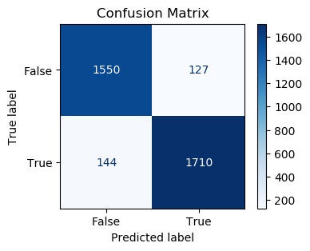
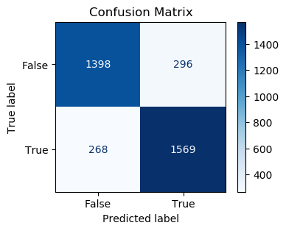
SVM with TF-IDF Vectorizer
DT with Count Vectorizer

Slide 19
Explainable Artificial Intelligence (XAI)
XAI Taxonomy
Examples (SVM model)

Slide 20
XAI - Taxonomy
Data Explainability
Clarity on the data used for training.
Model Explainability
Understanding model decisions.
1
2
Insight into model predictions.
Post-hoc Explainability
Evaluating the quality of explanations.
Assessment of Explanations
3
4
REF - Explainable Artificial Intelligence (XAI): What we know and what is left to attain Trustworthy Artificial Intelligence (Ali et al., Information Fusion, 2023).

Slide 21
XAI - Examples
Global Explanation
Local Explanation
Global explanations help us understand how a model works on the whole dataset by showing us which features are important and how well the model performs.
Local explanations focus on individual predictions, offering insights into why a specific decision was made.

Slide 22
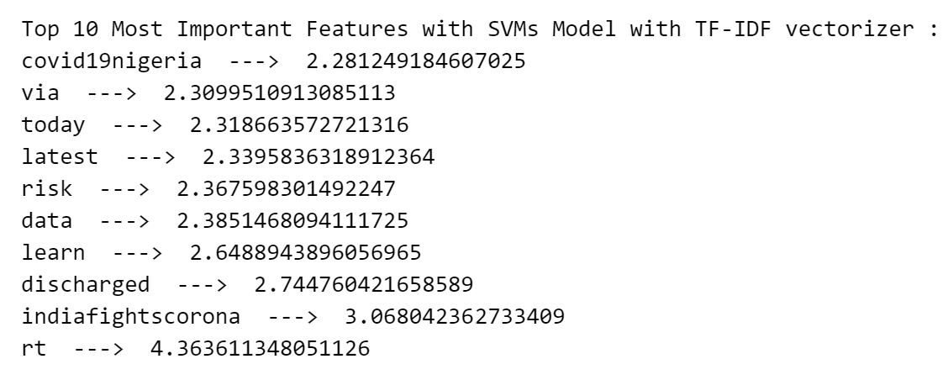
Global Explanation (SVM model)

Slide 23
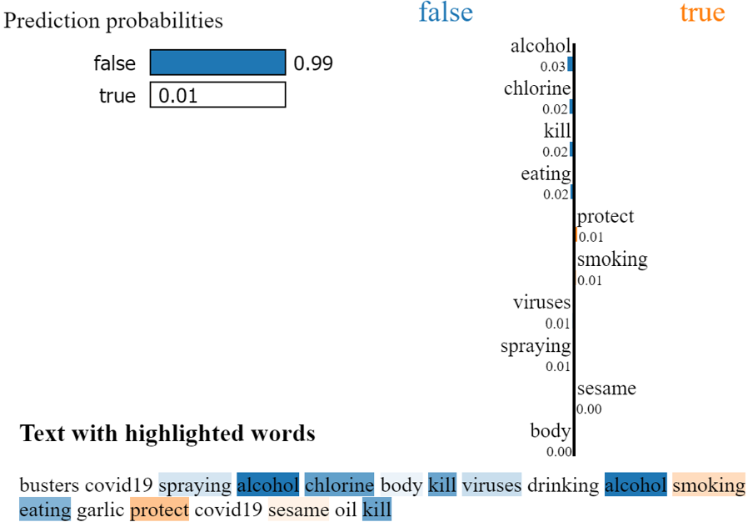
Local Explanation (SVM model) - True Prediction

Slide 24
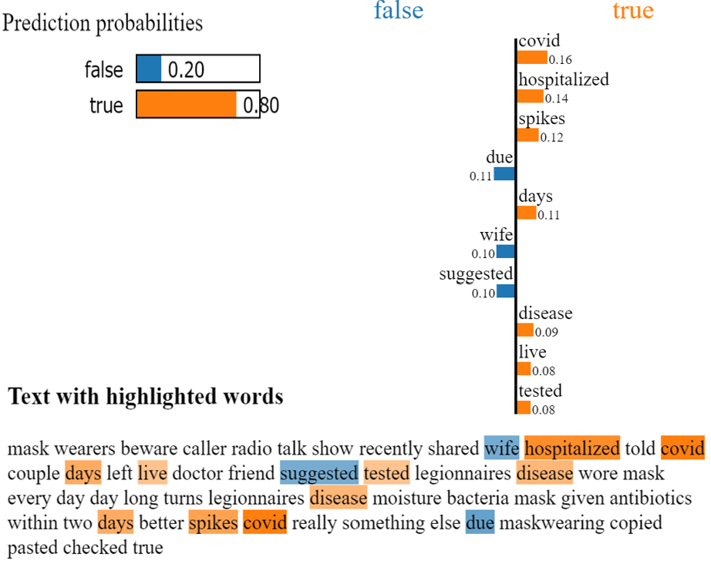
Local Explanation (SVM model) - False Prediction

Slide 25
Conclusion
Comparative study of five ML methods for fake news detection, serving as a foundational exploration in the XAI taxonomy.
Support Vector Machine with TF-IDF vectorizer has achieved the highest accuracy of 92.3%.
Adoption of a four-point XAI taxonomy, emphasizing transparency and trust in AI decision-making aligning with a human-centered approach.

Slide 26
Limitations & Future Work
Focused on best performing algorithm in XAI, potential limits to generalization.
Primary emphasis on global interpretability, with limited exploration of local methods.

Slide 27
Thanks!
Do you have any questions?
debby_yong123@hotmail.com
https://doi.org/10.1145/3633083.3633212

